Slide 1
Natural Language Processing with Disaster Tweets
Max Tjen and Jerry Xiao

Slide 2
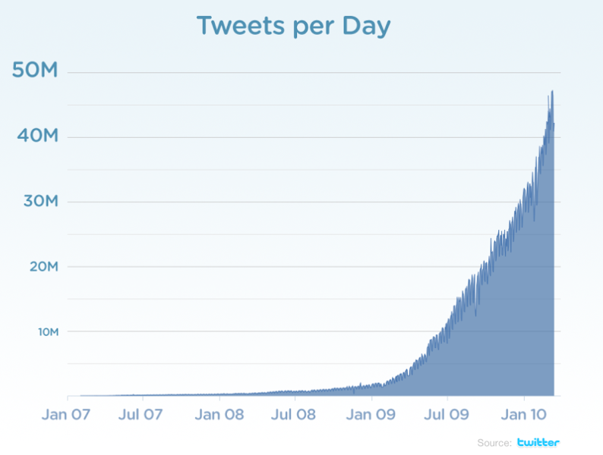
Background
Twitter has become a go-to platform for real-time public messages
6,000 tweets per second
⇒ 500 million tweets per day
Agencies are interested in monitoring Twitter
News agencies
Disaster relief agencies
Sentiment analysis: political figures, stocks, crypto, etc...

Slide 3
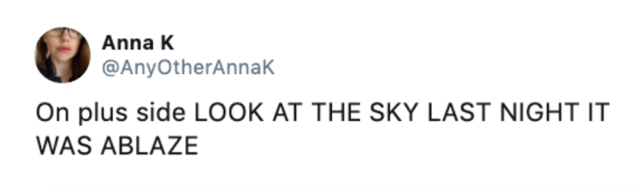
The Problem
Dataset of over 7,000 tweets
Each one may or may not be related to natural disaster
Classify each tweet: is it discussing a natural disaster or not?

Slide 4
Significance
Twitter is a huge trove of information
Monitoring Tweets could be be a way to gather information about important news events in real-time

Slide 5
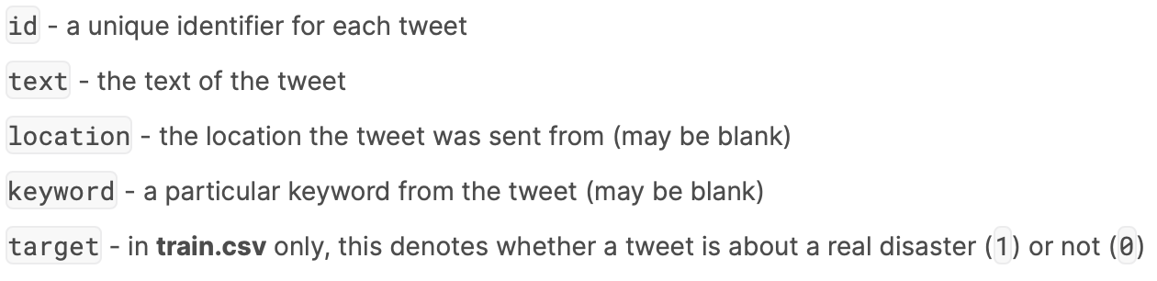
The Data
Train data (7614 rows, labeled) for building model
Test data (3264 rows, unlabeled) for predicting and submitting to kaggle
Given Variables:

Slide 6
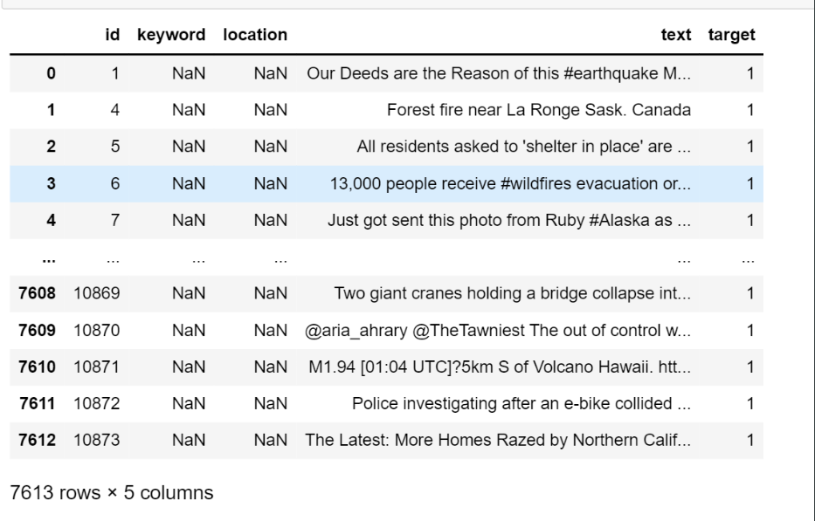
The Data

Slide 7
Relevant Works
Hong Kong Protests: Using Natural Language Processing for Fake News Detection on Twitter:
Dataset of tweets that are real/fake news regarding Hong Kong protests
Feature extraction
Features are purely linguistic
Tested Naive Bayes, SVMs, Decision Trees for predicting veracity of news
For all but random trees, top 10 correlated features are chosen and normalized
10 most significant features: tweet length, number of punctuation marks, number of periods, average number of characters per sentence, number of adverbs, number of “to”, number of verbs, number of entities(nouns), tweet entropy, TTR
Notes:
jerry

Slide 8
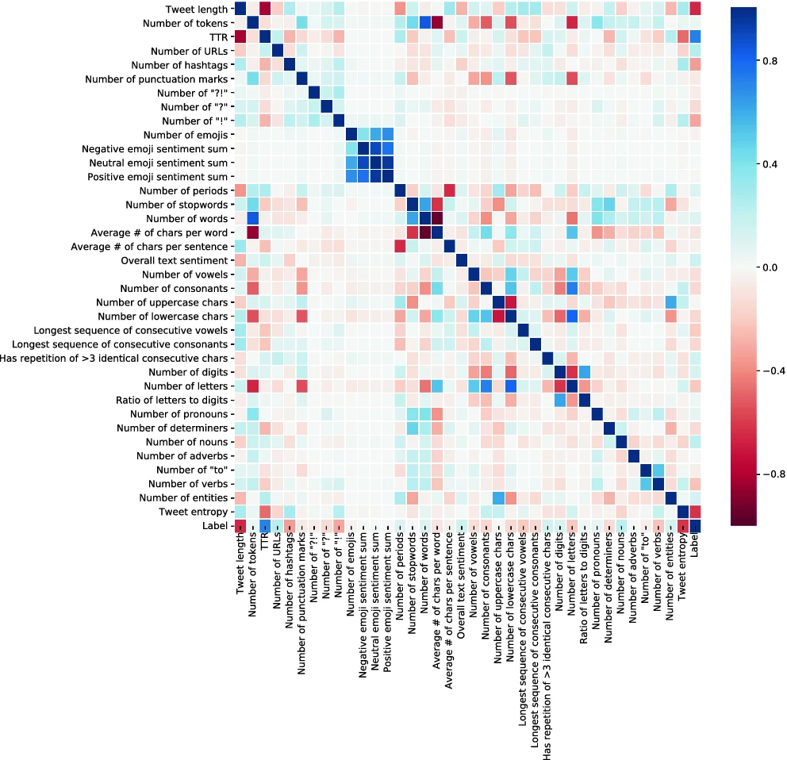

Slide 9
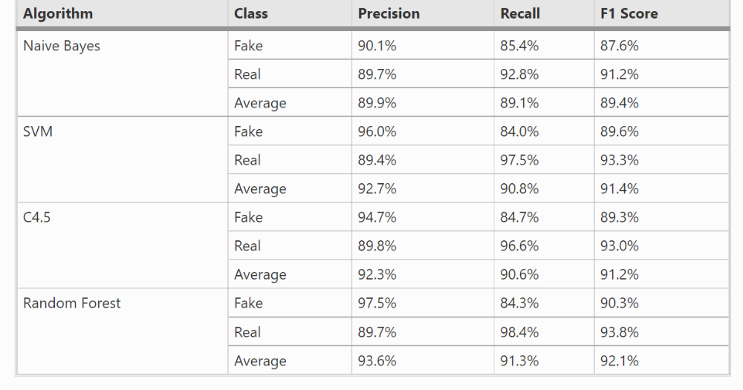
Results from Hong Kong paper

Slide 10
Relevant Works
Conclusions from Hong Kong paper:
Results indicate that tweets spreading fake news and real news differ notably in linguistic features.
Possible Caveats/Flaws:
Many tweets were translated from Chinese to english
No features related to user/network characteristics
Models tested aren’t very modern (could try NN’s)

Slide 11
OUR METHOD
We follow the same methods as the Hong Kong paper with some modifications:
Clean the Tweets
Extract linguistic features
Gather sentiment from tweets
RandomForest to classify based on our features

Slide 12
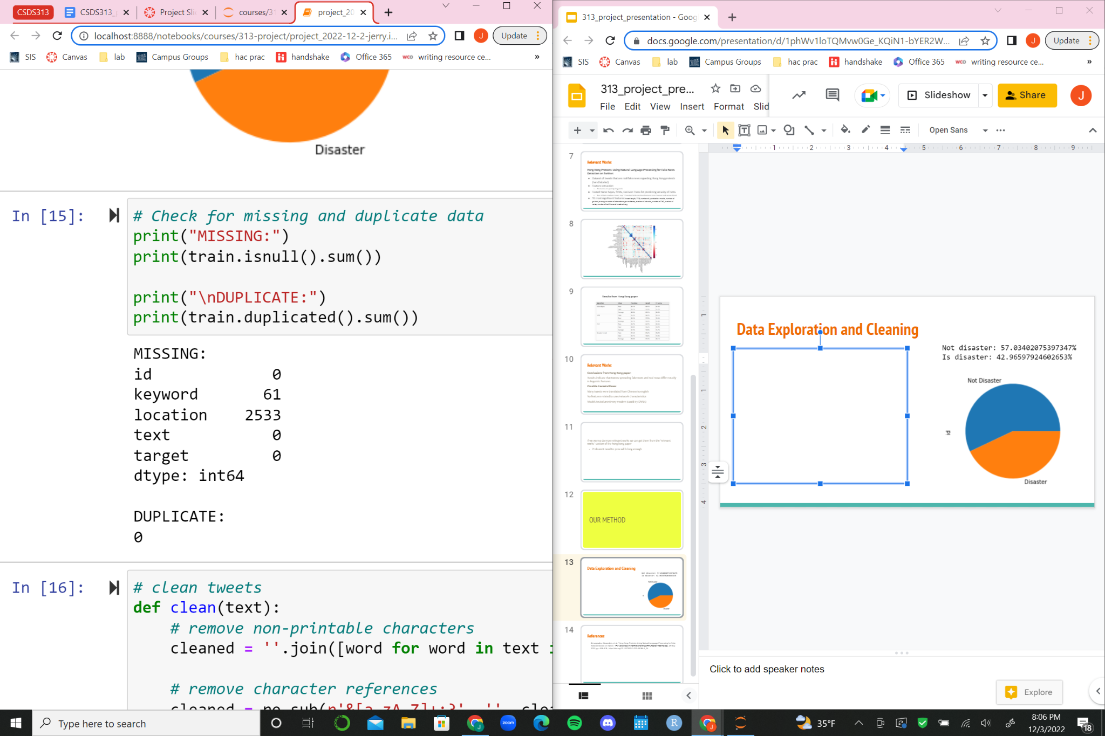
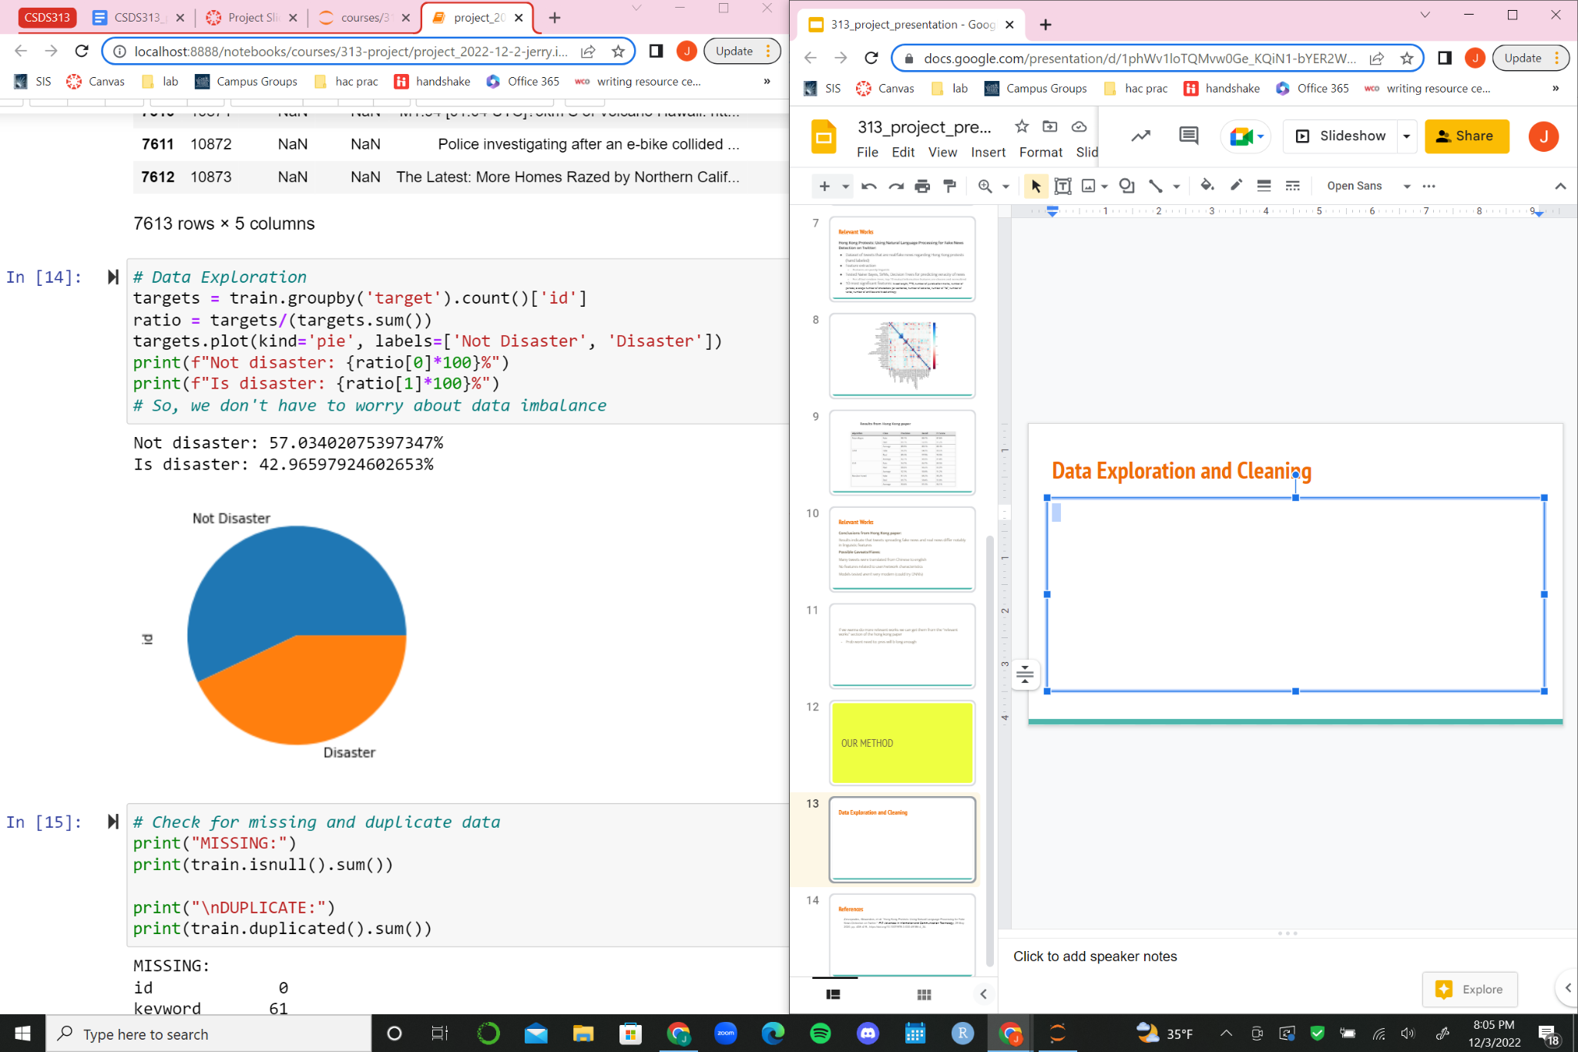
Data Cleaning

Slide 13
Data Cleaning
Non printable characters were removed (emojis, symbols)
Character references were removed (&amp;)
For Textblob and Vader sentiment
All letters to lowercase
All but alphanumeric stripped out

Slide 14
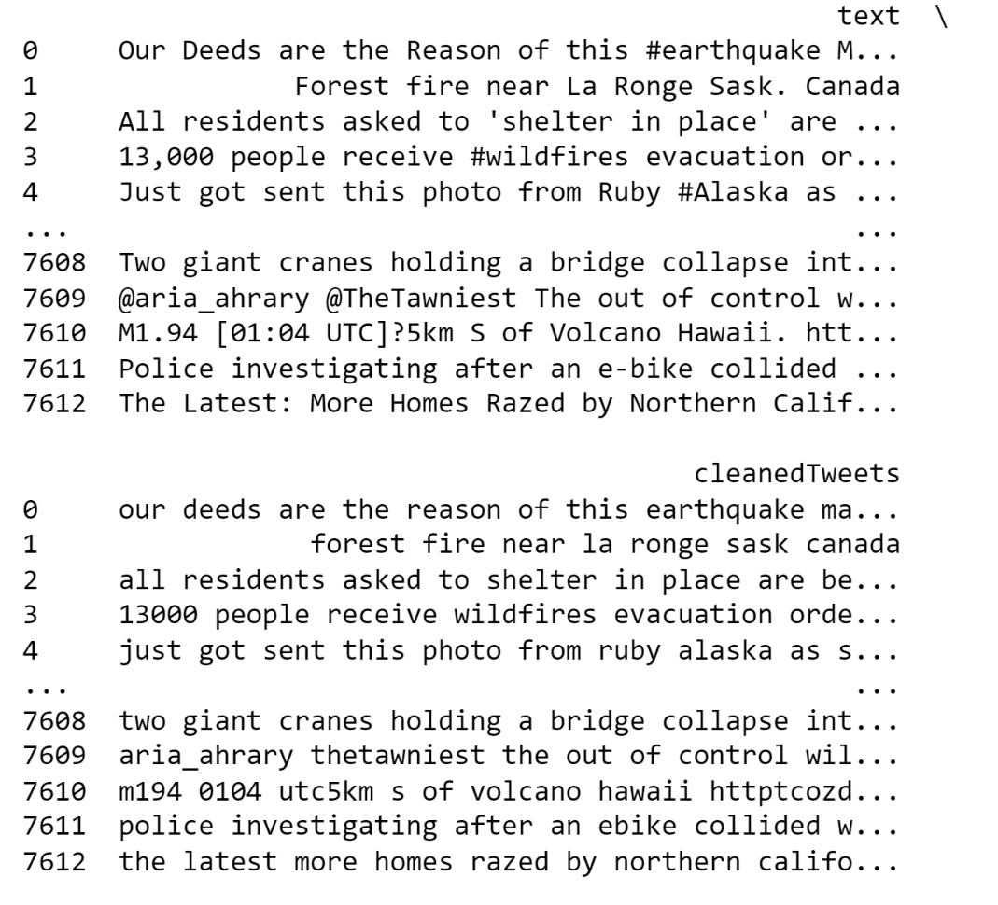

Slide 15
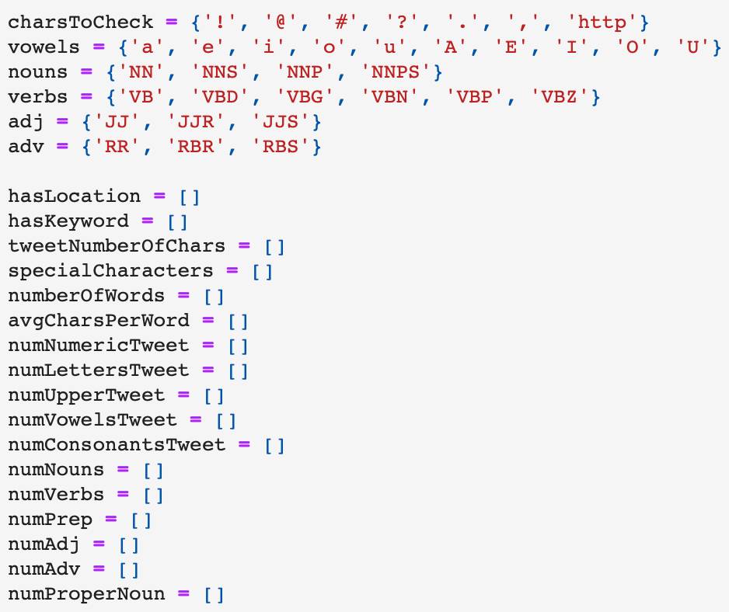
Feature Engineering
36 Predictive Features
Categories
Boolean
Overall Tweet Characteristics
Types of Word (grammar)
Sentiment
TTR and Entropy
Notes:
max

Slide 16
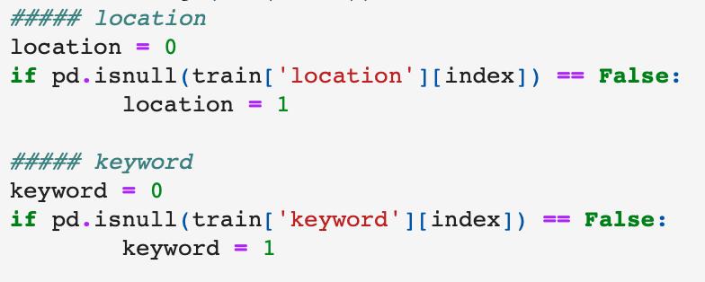
Feature Engineering: Boolean

Slide 17
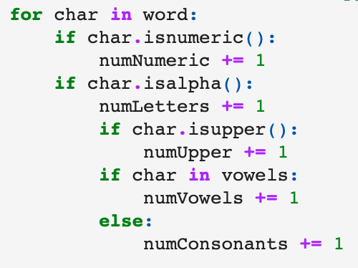
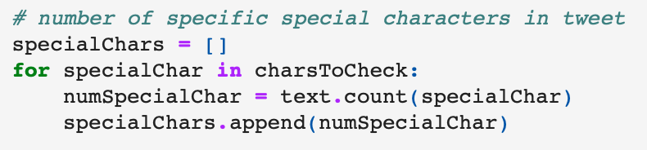
Feature Engineering: Overall Tweet
Bulk of features
Number of characters
Number of words
Number of special characters
! @ , # ? .
Average characters per word
Number or numeric and letters in tweet
Number of consonants and vowels
Number of special characters per sentence

Slide 18
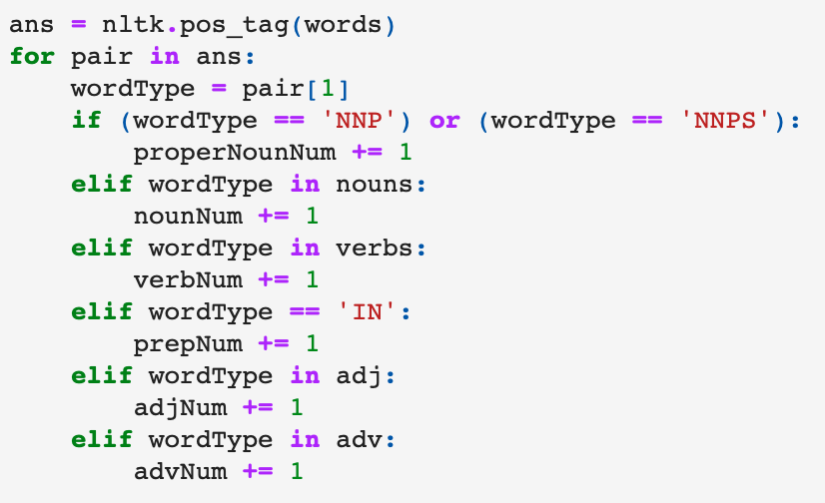
Feature Engineering: Grammar
NLTK package
Natural language toolkit
Pass array of words into function
Function tags each word
Add counts for each type

Slide 19
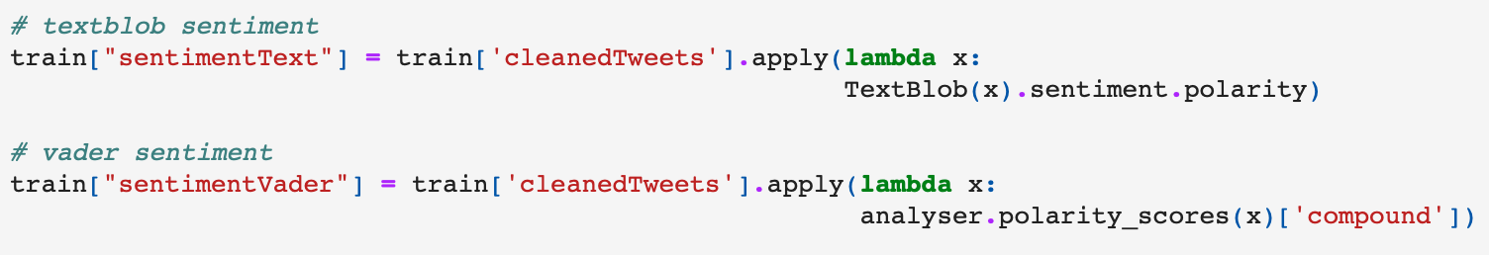
Feature Engineering: Sentiment
Representation of emotion in text
Textblob
Built on NLTK
Sees if a word is positive, negative, or neutral and then calculates average of text
Vader
Rule based (grammar and syntax conventions)
Dictionary of words that maps words to emotional intensity
Optimized for social media data - tuned for small amounts of text

Slide 20
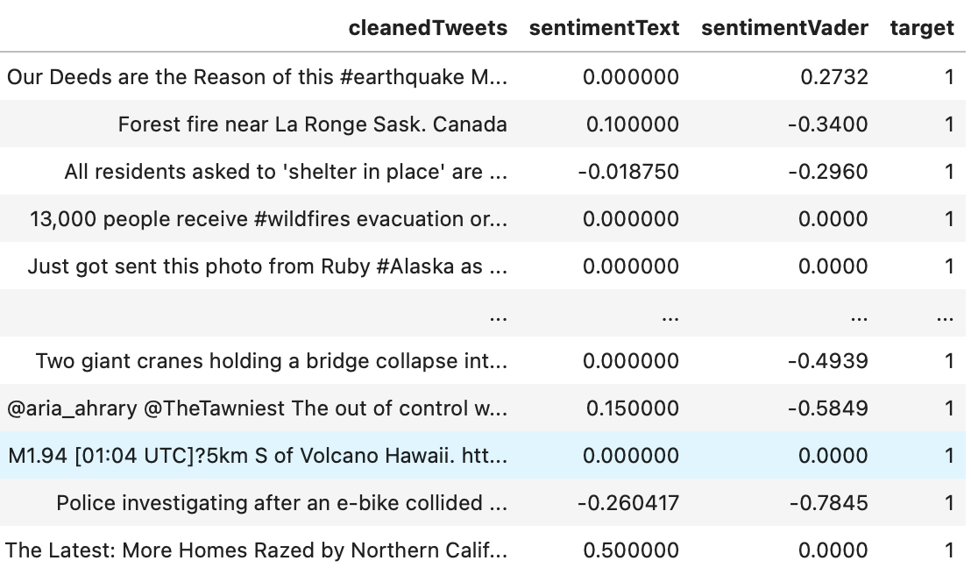
Feature Engineering: Sentiment

Slide 21
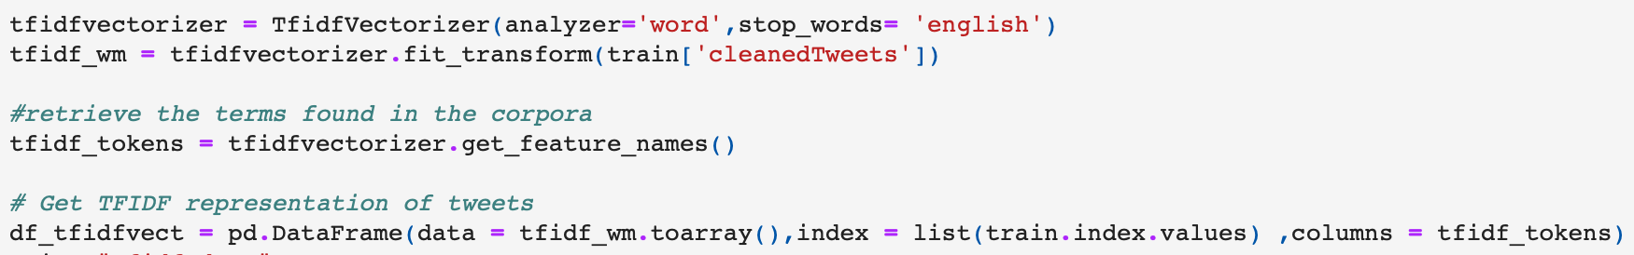
Feature Engineering: TTR and Entropy
TTR (type-token ratio) - total number of unique words divided by total number of words in a document (tweet)
Entropy - sum of all TF-IDF values of words for each tweet
Term frequency in document - inverse document frequency across set of documents
The more times a word is used ⇒ it is less important (ex. ‘and’)
Measure of word importance

Slide 22
Resulting Features
hasLocation
hasKeyword
tweetNumberOfChars
numberOfWords
numEx
numAt
numHash
numQ
numPeriod
numComma
numLinks
numPunc
avgCharsPerWord
numNumericTweet
numLettersTweet
numUpperTweet
numVowelsTweet
numConsonantsTweet
numNouns
numNouns
numVerbs
numPrep
numAdj
numAdv
charsPerSentenceTweet
numSentencesTweet
numProperNoun
numTo
ttr
entropy
hashPerSentence
wordsPerSentence
atPerSentence
commasPerSentence
linksPerSentence
sentimentText
sentimentVader

Slide 23
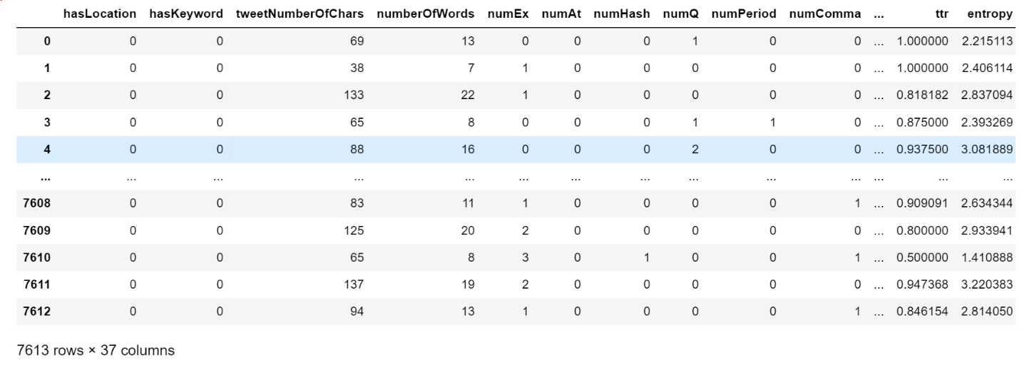
Resulting Features

Slide 24
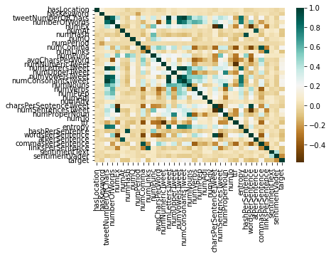
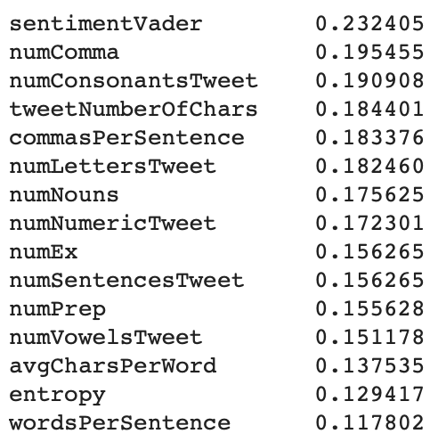
Resulting Features

Slide 25
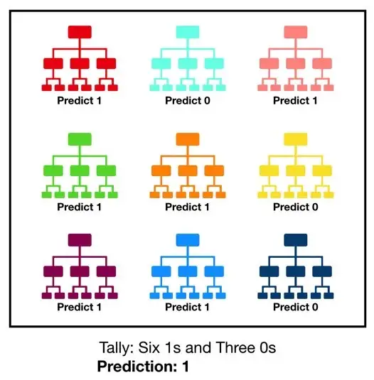
RandomForest Classifier
How it works:
Many individual decision trees: each makes prediction as a vote
Each tree gets a random subset of data with replacement, and random subset of features
More diversification, lower correlation across trees
Notes:
jerry

Slide 26
RandomForest Classifier: Default Model
80-20 train-test split
First trained on default RandomForestClassifier():
n_estimators = 100 100 trees
max_depth = none no max depth of trees
max_features = sqrt for each split, consider sqrt(num_features)
Notes:
TODO: PUT RESULTS HERE AFTER RUNNING

Slide 27
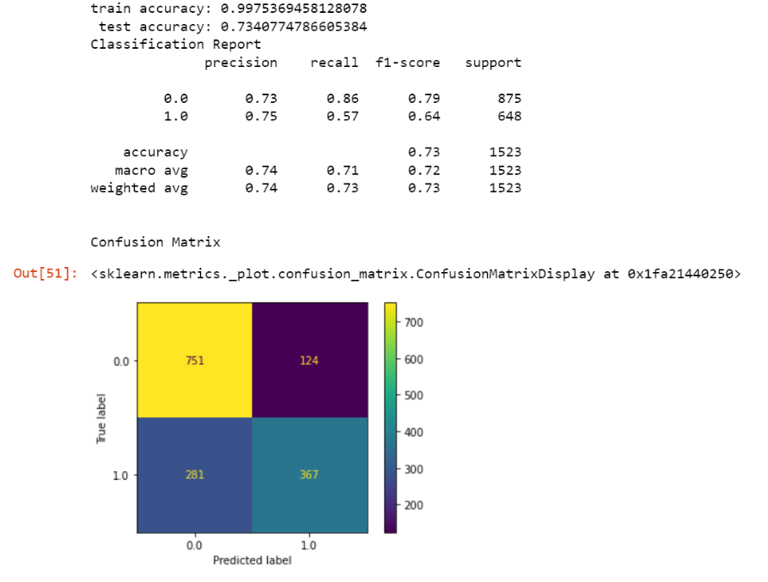
RandomForest Classifier: Default Model

Slide 28
RandomForest Classifier: Optimization
Hyperparameter Optimization:
Create a grid: n_estimators 200-2000
max_depth 100-500, none
max_features none, sqrt
Randomly search grid and test parameters (tested 50 candidates)
result: n_estimators: 200
Max_depth: none
max_features sqrt

Slide 29
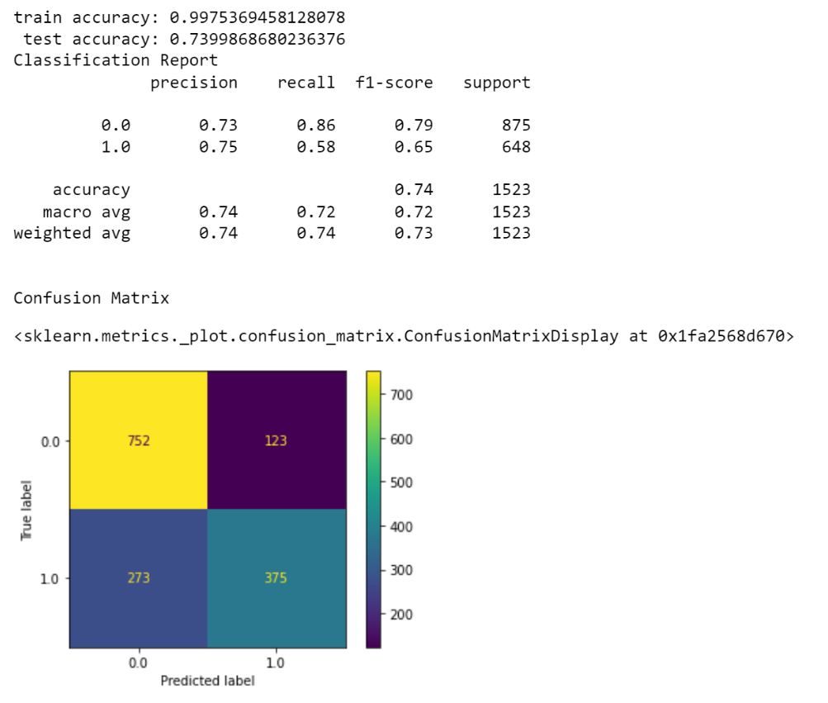
Results: Optimized Model

Slide 30
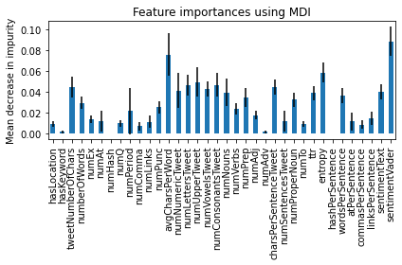
Results: Optimized Model

Slide 31
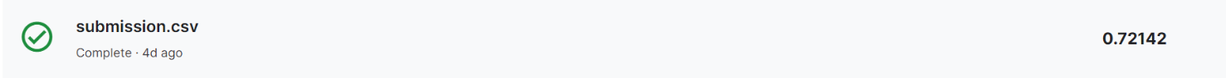
Results: Kaggle Competition Entry

Slide 32
Analysis
Our accuracy is much lower than the Hong Kong paper with similar methods:
Different implementation of entropy
Our data is generally less formal
In Hong Kong paper, all tweets were trying to look like real news
Our data contains a lot of normal tweets from normal users
Different data collection
Ours: pool of tweets chosen because of potential keyword
Theirs: had to separately procure fake news data and real news data: does not come from the same pool

Slide 33
Conclusion:
There is a difference in linguistic features between tweets regarding natural disaster and tweets not regarding natural disaster. The most significant features were:
Feature MDI
sentimentVader 0.088286
avgCharsPerWord 0.075707
entropy 0.058457
numUpperTweet 0.049401
numConsonantsTweet 0.046705

Slide 34
Conclusion: Future Work
More in-depth data cleaning
Twitter data generally requires more cleaning due to very relaxed grammar
Lots of acronyms, purposely misspelled words (yes vs. yesssss)
Method to validate location values
BERT (Bidirectional Encoder Representations from Transformers)
SVM (support vector machine)

Slide 35
References
Di Pietro, Mauro. “Text Analysis & Feature Engineering with NLP.” Medium, Towards Data
Science, 15 Mar. 2022,
https://towardsdatascience.com/text-analysis-feature-engineering-with-nlp-502d6ea9225d.
Zervopoulos, Alexandros, et al. “Hong Kong Protests: Using Natural Language Processing for Fake News Detection on Twitter.” IFIP Advances in Information and Communication Technology, 29 May 2020, pp. 408–419., https://doi.org/10.1007/978-3-030-49186-4_34.

